Slide 1

Optimizing inventory management for improving resource mobilization, growth and profitability of a retail pharmaceutical business
A ppt for the BDM capstone Project
Submitted by
Name: BINAYAK BANERJEE
Roll number:21F2000510
IITM Online BS Degree Program,
Indian Institute of Technology, Madras, Chennai
Tamil Nadu, India, 600036

Slide 2
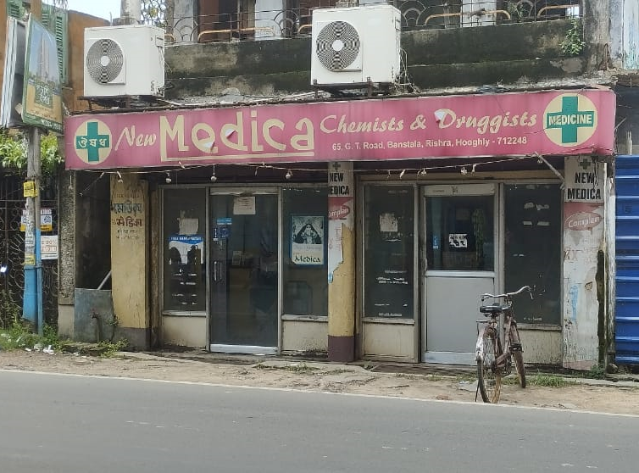
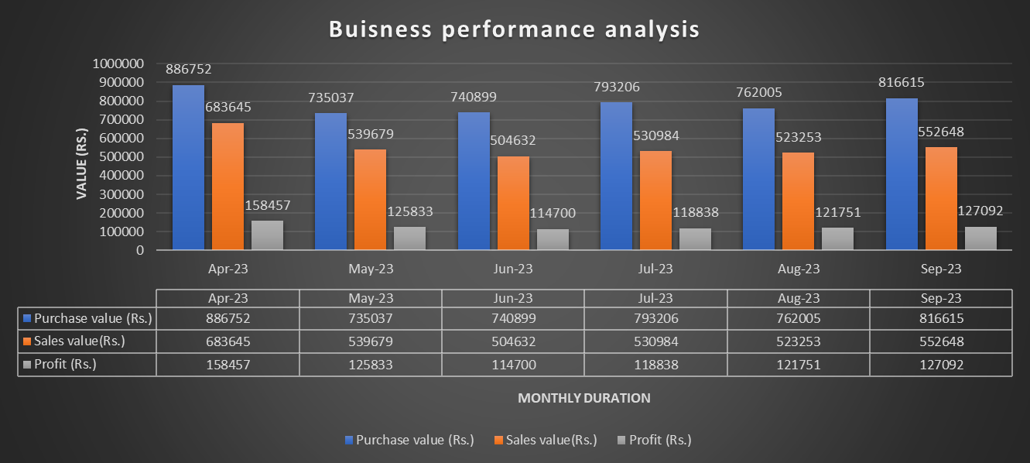
Introduction
New Medica - a retail pharmaceutical shop in Rishra, West Bengal
The business is B2C and deals in the segment of pharmaceutical retail business.
Partnership family business established in the year 1972.
Started as ‘Medica’ later in 2006 renamed as ‘New Medica’.
Serving the needs of the people of sub urban locality (population 1,74000 approximately)
Annual sales turnover of 78.3 Lakhs in the financial year 2022-2023
Business outlook and current challenges
Stiff competition from branded establishments-‘Apollo Pharmacy’ and ‘Frank Ross’ and online medical stores like ‘Sastasundar’,’1mg’etc.
Highlights of business performance over the study period of six months (April 2023 to September 2023):
1.Total purchase value=Rs 47,34,514/-
2.Total sales value=Rs 33,34,841/-
3.Total profit=Rs 7,66,671/-
Inventory management inefficiencies.
Stockouts, overstocking, and wastage due to expiry.
Cash flow constraints and resource blockage
Objectives
Improve inventory management system
Proper resource allocation to enhance resource mobilization.
Improve profitability by optimizing inventory.

Slide 3
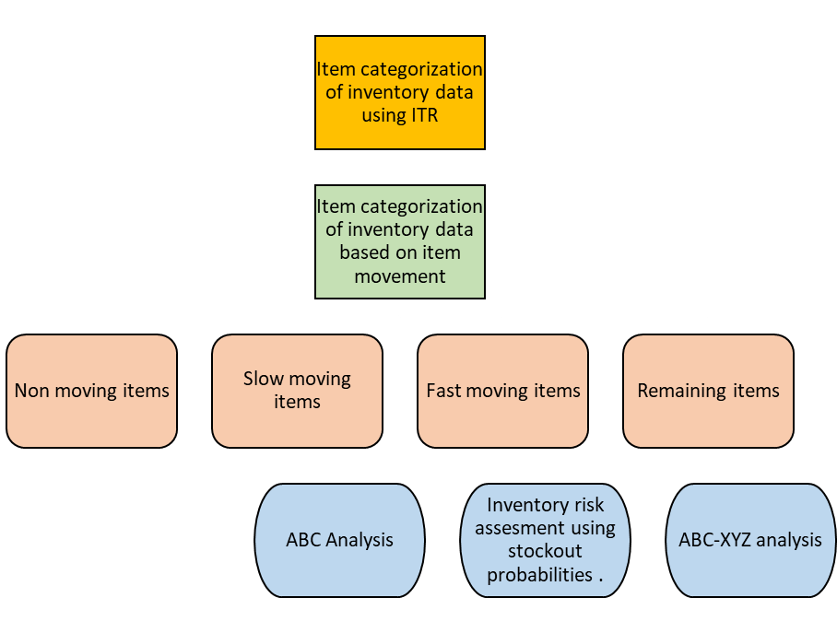
Data collection, pre-processing ,analysis & methodology
Business data of New medica has been collected over a period of 6 months (April-2023 to September 2023).
Primary data includes bills of purchase and sales transactions as well as monthly inventory data over the review period has been collected.
Data pre-processing involved the steps of data cleaning,validation and removal of duplicate entries.
Data pre-processing is performed using Python and for further analysis MS-Excel has been used.
Flowchart of analysis process
Analysis methods:
Inventory Turnover Ratio (ITR)
Inventory Movement Categorization Analysis
ABC Analysis
Inventory Risk Assessment Using Stockout Probabilities
ABC-XYZ Analysis

Slide 4
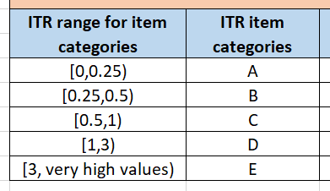
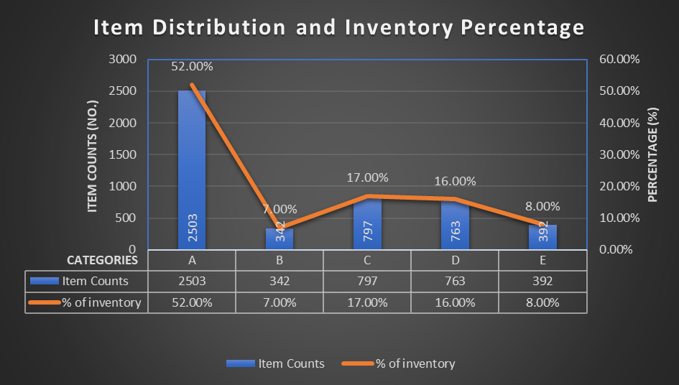
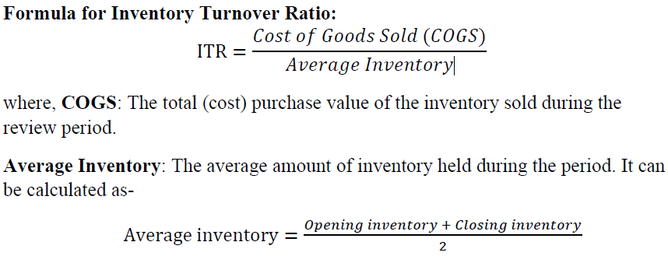
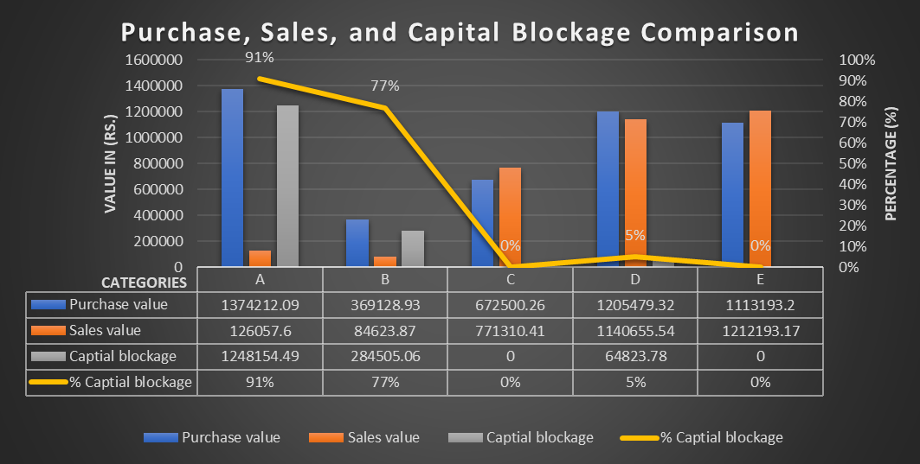
Inventory Turnover Ratio (ITR)
Formulation:
Significance:
High turnover ratio indicates strong sales or effective inventory management by reducing holding costs.
Low turnover ratio indicates slow-moving inventory, potential overstocking, or weak sales. The business may be holding excess inventory
Key Findings:
High Capital Blockage in Low ITR Categories (A and B).
Healthy Performance in Categories C, D, and E
Resource Mobilization and Profitability:New Medica's profitability and resource mobilization are impacted primarily by overstocked and slow-moving items. Addressing these categories will significantly improve cash flow and reduce blocked capital.

Slide 5
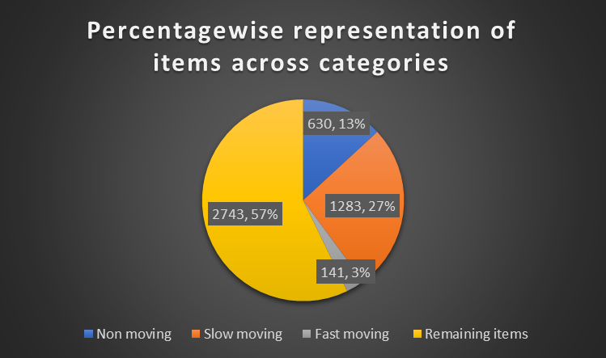
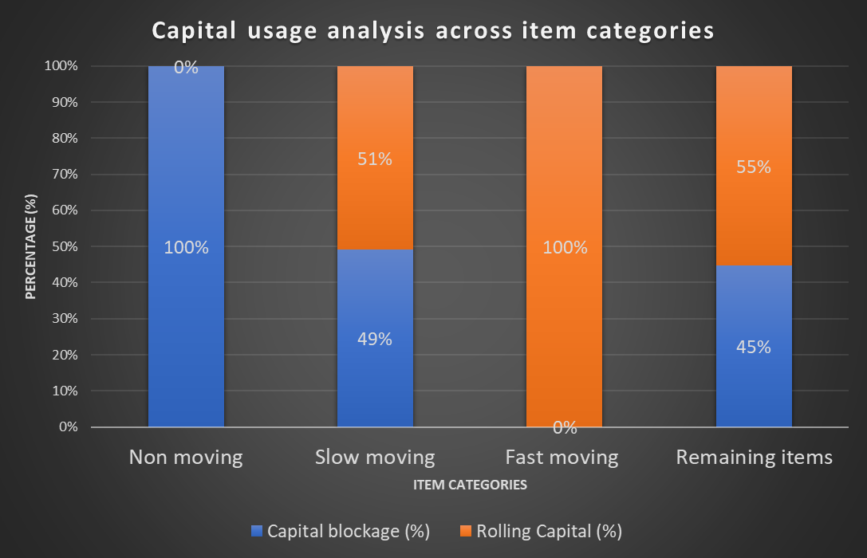
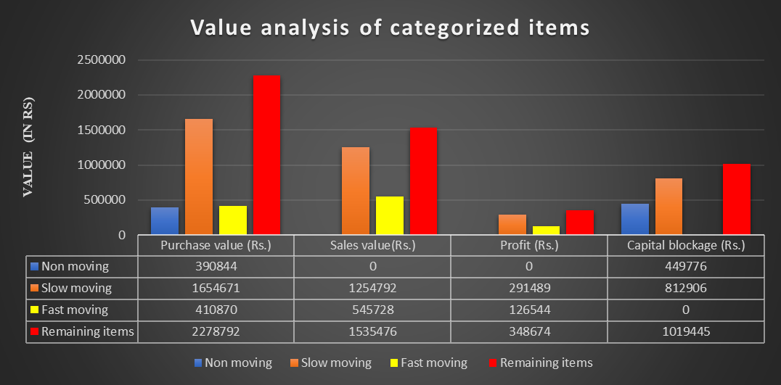
Inventory Movement Categorization Analysis
Item categorization:
Non-moving items:The items whose stock in hand are twice the average monthly purchases and total sales are NIL.
Slow-moving items: Items whose stock in hand are twice the average monthly purchases and total sales are not NIL.
Fast-moving items:Items whose average monthly purchases and average monthly sales are equal.
Remaining items: Rest items in the total inventory not fulfilling the criteria of any one of the above three categories.
Key Insights:
Non-Moving Category: No sales have been recorded in this category, leading to zero profit and the largest capital blockage.
Slow-Moving Category:Moderate profit margins and high capital blockage.
Fast-Moving Category:Most efficient net capital usage and no capital blockage.
Remaining Items::highest net capital usage and high capital blockage .

Slide 6
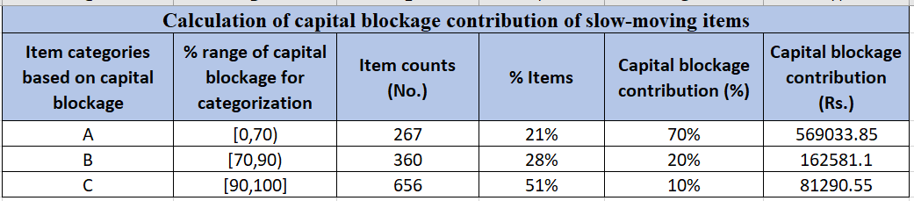
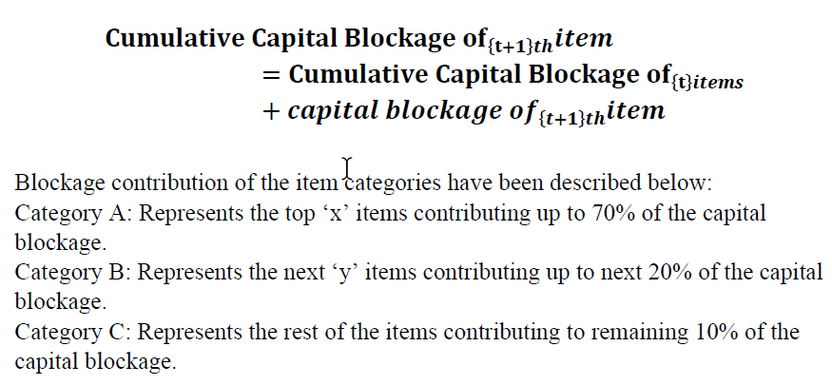
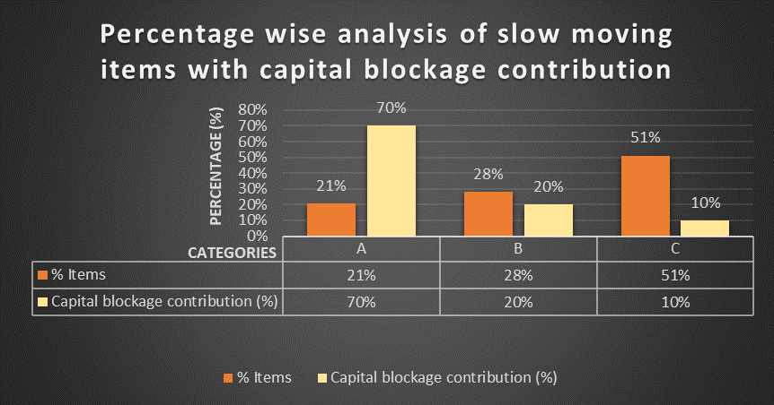
ABC Analysis
Significance:
Performed over the slow-moving items (1283 items)
Items are categorized as A, B & C as per the cumulative blockage(%) contribution.
Formulation:
Key insights:
Category A:High capital blockage in this category, despite the smaller number of items.
Category B: Moderate capital blockage impact, but they still hold significant value.
Category C:Capital blockage contribution per item is the lowest, indicating that this category is less critical in terms of capital inefficiency.

Slide 7
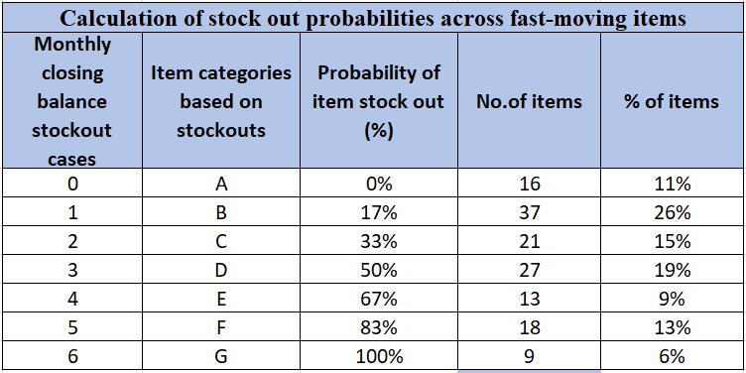
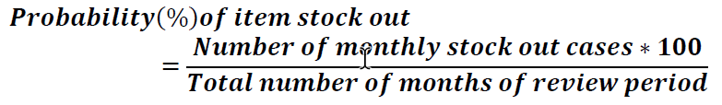
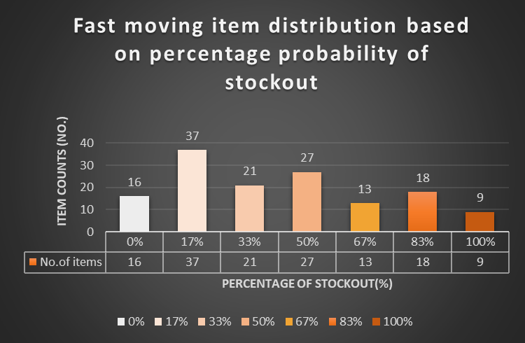
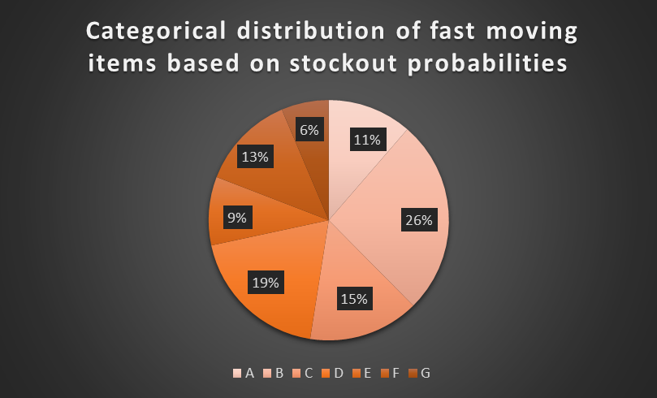
Inventory risk assessment using stockout probabilities
Significance:
Performed on the fast-moving items (141 items).
Categorizes items based on risk associated for a stockout situation.
Formulation:
Key insights:
Category G items have a guaranteed stockout issue.
Categories E & F comprising of 32% of the items have a high probability for stockout.
Categories (B to D) comprising of 55% items, is associated with moderate to high-risk of stockout indicating a need for stronger inventory management and restocking procedures.
Categories A and B representing 37% of the total fast-moving items follow well-maintained inventory practices.

Slide 8
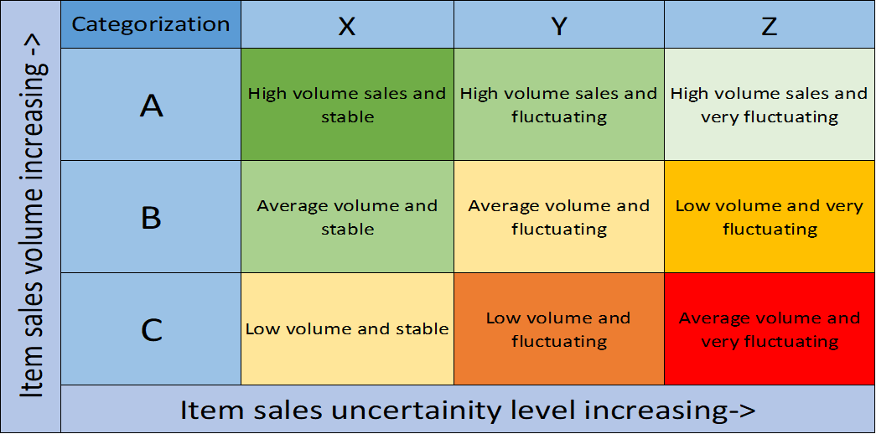
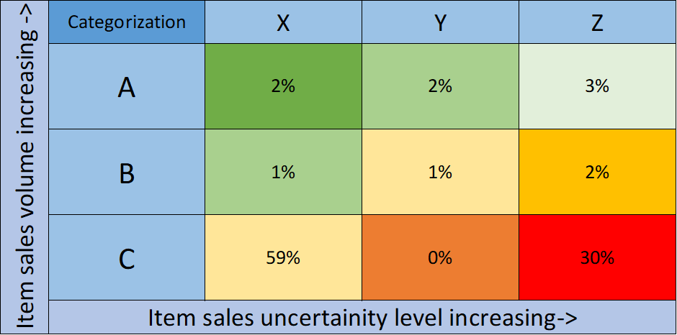
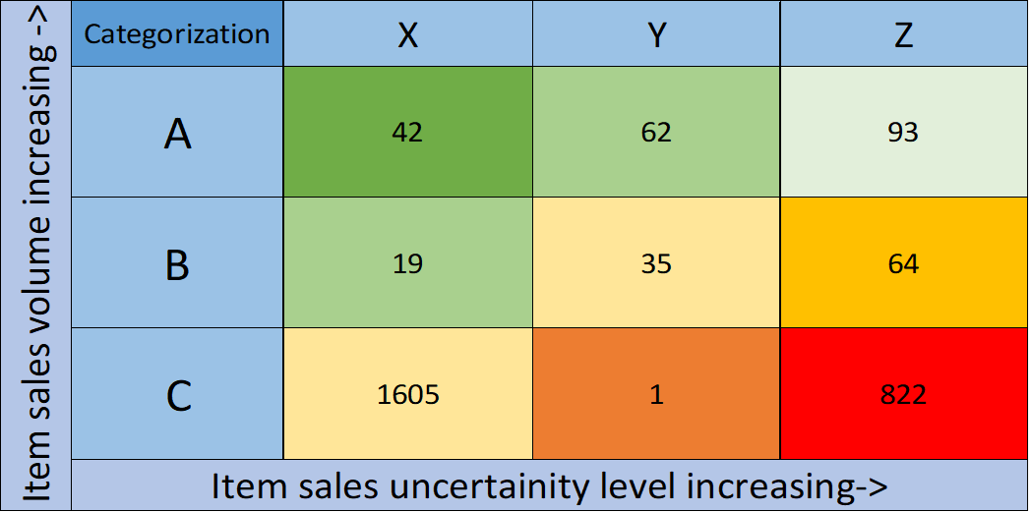
ABC - XYZ Analysis
Significance of item categories
Significance:
Performed on the remaining items (2743 items).
Categorizes items based on their importance in terms of value as well as demand stability.
ABC analysis classifies inventory into three categories based on their importance in terms of sales value generated
XYZ analysis classifies inventory based on the variability of demand or consumption.
Categorizations:
Category A: Represents the top ‘x’ items contributing up to 70% of the overall sales value.(197 items - 7%)
Category B: Represents the next ‘y’ items contributing up to next 20% of the overall sales value.(118 items - 4%)
Category C: Represents the rest of the items contributing to remaining 10% of the overall sales value.(2428 items - 89%)
Category X:For the category of items percentage coefficient of variation ranges from [0,25).(1666 items - 62%)
Category Y:For the category of items percentage coefficient of variation ranges from [25,40).(98 items - 3%)
Category Z:For the category of items percentage coefficient of variation ranges from [40,224(max. value)).(979 items - 7%)
Item counts across item categories
Percentage-wise representation of items

Slide 9
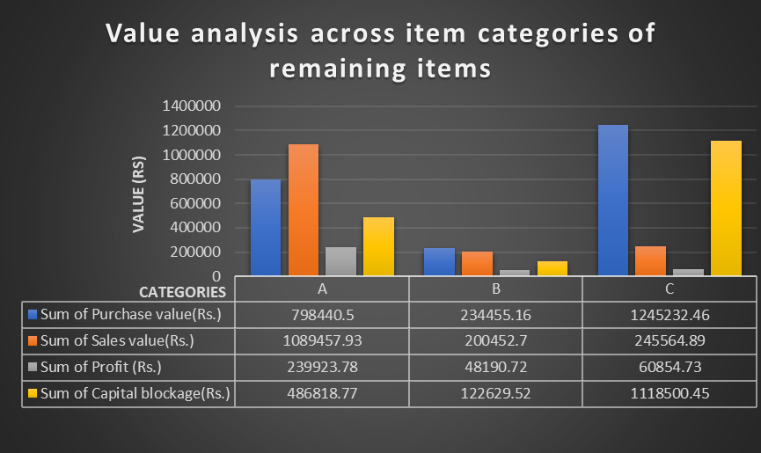
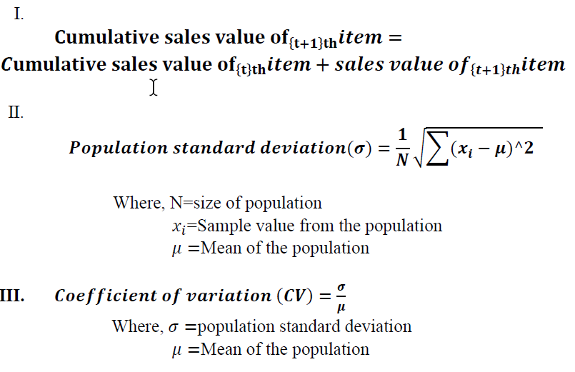
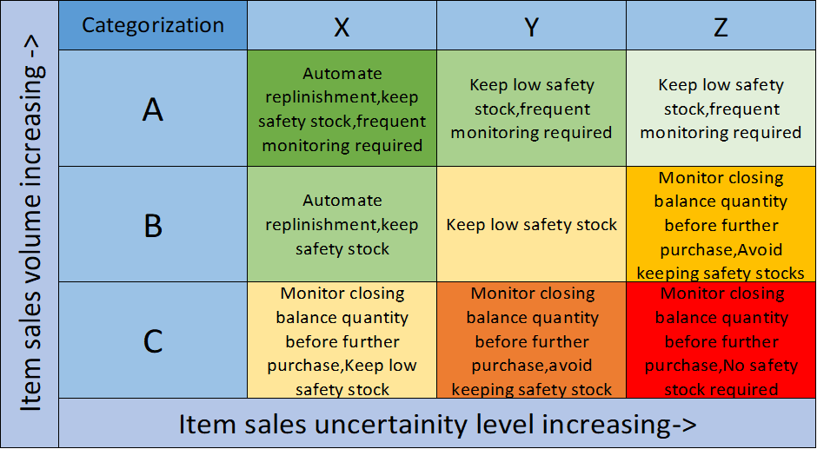
ABC - XYZ Analysis
Formulation:
Key Insights:
Category AZ: Comprises of (93 items) which has high sales volume but very fluctuating demand, requiring close monitoring and frequent adjustments to inventory levels.
Category BZ: (64 items) shows significant demand fluctuation, so these items require careful monitoring and stock control to avoid excess.
Category CX: 1605 items are in this category (low volume and stable), showing little fluctuation but contributing significantly to overall stock count.
Category CZ: (822 items) in this category is concerning, as these items have high fluctuation, requiring careful analysis to avoid excess inventory.

Slide 10
Interpretation of analysis and recommendations
Non-Moving Items:Liquidating non-moving items to free up capital (₹449,776) currently blocked.Implement strategies like deep discounts, promotional sales.Explore possibilities for returning non-moving items to suppliers or exchanging them for more fast-moving inventory.
Slow-Moving Items:Category A of slow-moving items immediate attention should be given to freeing up capital by reducing stock levels in these categories through targeted promotional activities, supplier negotiations, or stock liquidation.Items in this category account for 21%(267 items) of total slow-moving items that contributes 70% of the capital blockage.Next in priority order should be Category B represents 28% of the total slow-moving items (360 items), contributing 20% of the capital blockage.Category C contains the largest number of items, representing 51% of the slow-moving inventory (656 items). However, they contribute only 10% of the capital blockage.Despite having the most items, the capital blockage contribution per item is the lowest, indicating that this category is less critical in terms of capital inefficiency.
Fast-Moving Items:Constitutes 3% of the overall inventory with 141 items.Focus on categories D, E, F, and G (high to critical stockout risk) for continuous inventory replenishment to avoid lost sales. Strengthen predictive demand analytics to ensure uninterrupted stock availability.Use automated replenishment systems for fast-moving items with a low probability of stockouts (Categories A and B) to maintain stock levels efficiently.
Remaining Items: This is the largest category, comprising 2,743 items (approximately 57% of the total volume) which contribute to 45% capital blockage and 55% rolling capital, indicating moderate efficiency.Nearly half of the net capital is locked up in non-performing inventory.Category A consists of high-value, high-profit items, it should be prioritized for automation and frequent monitoring to ensure supply meets demand.Category C constitutes the largest percentage (59% in X and 30% in Z) of stock but of low-value and demand fluctuating items.These items tie up large amounts of capital but offer lower returns, inventory should be minimized through better forecasting and frequent stock monitoring to reduce wastage and excess holding costs.
Data Limitations:The dataset used only covers a 6-month period, which might not fully reflect seasonal trends or other long-term market behaviors affecting inventory movement.Expanding the data collection period to include at least a year’s worth of transactions would provide better insight into seasonal and yearly inventory trends.
Incorporation of Advanced Predictive Models:Integrating machine learning-based predictive models using external factors like consumer behavior, economic trends, and competitor analysis could enhance demand forecasting and inventory optimization.A more dynamic forecasting model can account for real-time variations in demand and external disruptions.
Supplier and Lead Time Analysis:Conducting an in-depth supplier performance analysis, including delivery times, reliability, and pricing strategies, can help optimize procurement processes, leading to better cost control and reduced stockout risks.
Pricing and Discount Strategy Analysis:A deeper exploration into pricing strategies, discounts, and promotions could help understand how to improve sales value without sacrificing profit margins.
Limitations and scope for improvement

